Slide 1

DATA NETWORKS
LESSON 1

Slide 2
Introduction to Computer Networks
Learning outcomes:
Understand the concept of computer networks.
Identify and explain the roles of the basic components of computer networks.
Types of network topologies
Computer Networking: A Top-Down Approach. 7th edition. Jim Kurose, Keith Ross – Pearson (2017).

Slide 3
Basics of Computer Networks
Terminologies / definitions:
Computer Networking is the practice of connecting computers and other computing devices to enable communication and data exchange.
Computer Network connection of 2 or more computing devices that exchange data.
Networks ranges from small local setups to huge, global networks e.g. the internet).
Data is information that is stored in digital form and transmitted between the sender and receiver over the network, e.g. text, files, music, video, image etc.
Data Transmission is the transfer/movement of data between two or more devices over the network.

Slide 4
Basics of Computer Networks
Terminologies / definitions:
Topology: is the physical and/or logical layout of devices on a network.
Topologies defines how the devices are connected to each other, how the data flow within the network, devices communication.
Internet Protocol(IP) Address is a unique identifier that is assigned to every device to identify it on a network and enable communication over the internet. e.g 192.168.50.81
Media Access Control(MAC) address: is a unique device identifier assigned to network interface card of each device for communication on a local network.
MAC address are primarily used for local communication within a network.
Host is any device that is connected to a network and runs processes that initiate data communication with other devices. Also referred to as End devices
Bandwidth: The maximum amount of data that can be transmitted over a communication link in a given amount of time (Speed of the network). (bps), (kbps),(Mbps), (Gbps).
e.g If bandwidth is 20 Mbps (Megabits per second), it means the connection can transmit up to 20 million bits per second.

Slide 5
Why Networking ?
Resource Sharing: Share hardware (printers, scanners), software, and data.
Communication: Enables communication via email, video conferencing, and instant messaging.
Data Exchange: Facilitate the File transfer facilitation. transferring information between devices.
Centralized Management: Manage and monitor devices and users from a central point (server).

Slide 6
Components of a Network
Devices: (Compting devices) - 2 types of network devices:
Edge devices: Devices used by end users, e.g. Computers, smartphones, servers etc.
Core devices: Key devices that help transmit user data e.g. Routers, switches, hubs, and access points.
Communication Links: The channels through which data is transmitted between two or more devices, enabling the exchange of data and allowing communication to occur.
Wired: Ethernet cables, fibre optics.
Wireless: Wi-Fi, Bluetooth, cellular/broadband networks.
Protocols: Standards/ rules that govern how data is transmitted, received, and processed over the network. Rules for network communication (e.g., TCP/IP, HTTP, FTP)- ensures interoperability

Slide 7

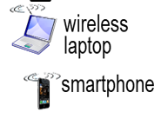
Network Edge Devices:
Client
An end-user device or application that requests access to resources, services, or information from a server.
Desktop computer, laptop, tablet, smartphone or any device used by an individual.
web browser, email client, file transfer program, or any other application that initiates communication with a server is a client.
Some types of services requested by clients include web pages, files, database queries, email retrieval, and more.

Slide 8

Network Edge Devices:
Server
A server is a computer that runs specialized services to serve other computers on the network or internet with resources.
A single server can have a single or multiple roles and functions, serving different purposes within a network.
Types of common servers on a network:
Web server: delivers web pages on request(host websites)
File server: Server that stores files and provides access to files.
Mail Server: Hosts mail
Print Server: Manages printing services

Slide 9
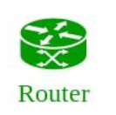
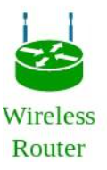
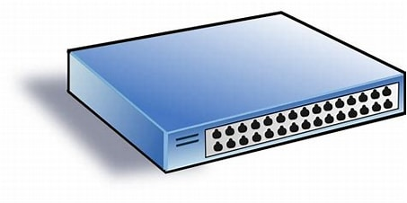
Network Core Devices:
Router
Calculates and selects the path for user traffic and forward (route) the traffic.
A router connects multiple networks (internal to external).
It receives packets, analyses packets, and decides the best route to its destination
Uses the IP address to forward packets – layer 3.
It connects a LAN to the WAN or LAN to LAN - All traffic enters and exits the network through this point (Gateway).
Switch
Used to connect multiple end devices to the network. E.g. in the FCI labs, all the workstations are connected to the switch using ethernet cables .
A switch is a device that connects devices within the same network.
It forwards data in the form of data frames using MAC addresses – layer 2.
Types: Unmanaged, Managed Switches, Layer 3 switches

Slide 10
Network Core Devices:
Wireless Access Point
Device that Connects wireless devices to a data network, e.g. smartphone.
An access point (AP) is a device that provides LAN access for wireless devices
It transfers data between the wireless and the wired LAN
APs have a specific range within which their signals can be received
Hub
Device that Connects multiple devices on a wired network
Hubs cannot filter data, so data packets are sent to all devices connected to it (broadcast) e.g Network monitoring <> devices on the network.
Repeater
Regenerates a weak signal so it can travel a longer distance.
Prevents the signal from becoming too weak or corrupted to extend the length to which the signal can be transmitted over the same network.

Slide 11
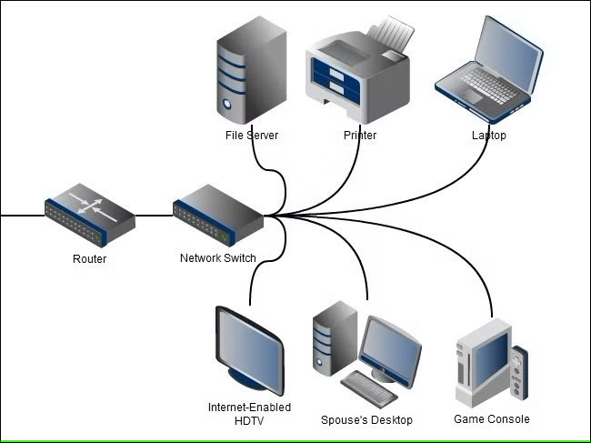
Basic network communication (LAN)
https://www.google.com/search?q=network+hub+symbol&sca_esv=32cceb17385ab000&udm=2&biw=1536&bih=739&sxsrf

Slide 12
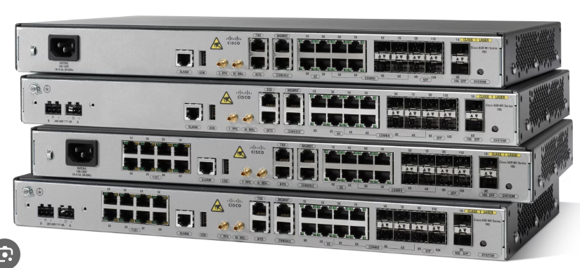
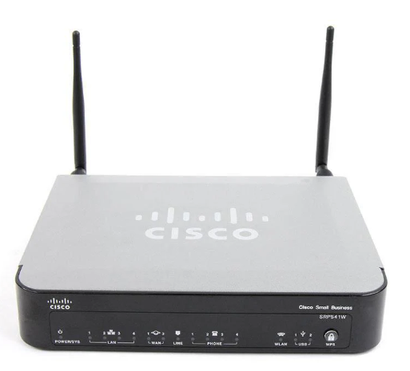
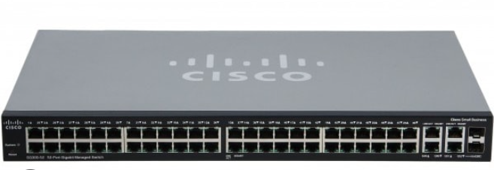
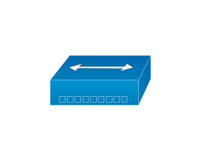
Network Core devices
Router
Wireless Router
Hub
Switch

Slide 13
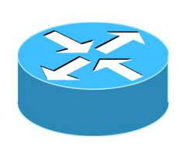

Network Core devices - icons
Router
Switch
Hub

Slide 14
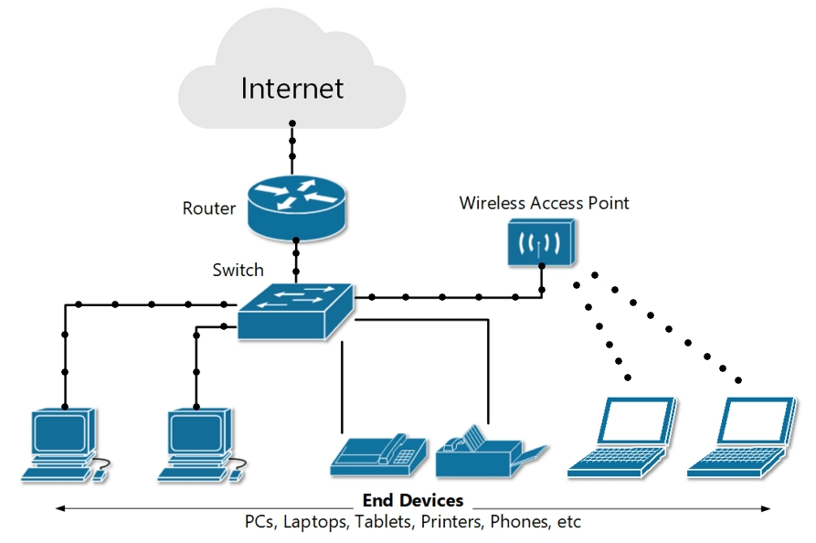
















The internet
A global connection of networks is the internet.
The internet connects (academic, government, organisation, privates networks worldwide).
network of networks” - Interconnected Internet Service Providers(ISPs)
It enables devices in these networks to be interconnected and share information. (E.g. accessing google from your home network).
mobile network
global ISP
home
network
regional ISP
institutional
network
https://www.google.com/search?q=Picture+of+how+the+internect+is+connected+from+small+networks&sc

Slide 15
Network Protocols
Protocols are standard in network communication.
They ensure that different devices from varying manufacturers, running different operating systems, connected to different networks can communicate effectively (interoperability).
Types of network protocols
Transport Layer Protocols:
Ensure end-to-end communication between devices and error handling between devices in a network. e.g TCP and UDP
Routing Protocols:
Determine the best path/route for data to travel across networks. (e.g RIP, OSPF, BGP…..)
Network Management Protocols:
Used to monitor the network devices and infrastructure. e.g SNMP, ICMP
Application Layer Protocols:
Enables applications to communicate over the network. e.g Web client & Web server uses HTTP
Security Protocols:
They ensure secure data exchanged over a network remains sec
SSL (for data encryption), SSH (secure access to remote systems).

Slide 16
What’s a protocol?
Protocols define the format, order of messages sent and received among network devices and actions taken on message transmission.
All communication activity in computer networks are governed by protocols
Protocols provide a standardized way for systems to interact
Different protocols are used to accomplish different communication tasks.

Slide 17
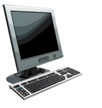
What’s a protocol?
E.g for a web client to access a resource from a web server, they need to follow certain protocols (rules).
TCP connection
request
TCP connection
response
Get http://www.awl.com/kurose-ross
<file>

Slide 18
Network Information/ Settings needed for connectivity
Devices need the following settings/ parameters to allow the computer to connect to and communicate with other devices on the network
Hostname:
- A human-readable name assigned to a device.
An easy-to-remember name for identifying and accessing the device within the network
e.g srv-finance-01
IP address:
- A unique logical address used to identify devices on a network, e.g 192.168.4.5
Assigned either statically (manually) or automatically (by DHCP server)
Subnet Mask:
An address that identifies the subnet/network in which a device belongs to e.g 255.255.255.0
MAC Address
- A unique physical address used to identify a network device on a local network
Assigned by the manufacturer of the networking device (NIC)
Default gateway
Used as an exit/entry point to/from a network.
Device that allows hosts in a local network (LAN) to communicate with devices in external networks by forwarding packets between the local and external networks.
DNS address
IP address of the DNS server which translates domain names to their IP addresses and vise versa
e.g www.google.com into 142.250.190.78

Slide 19
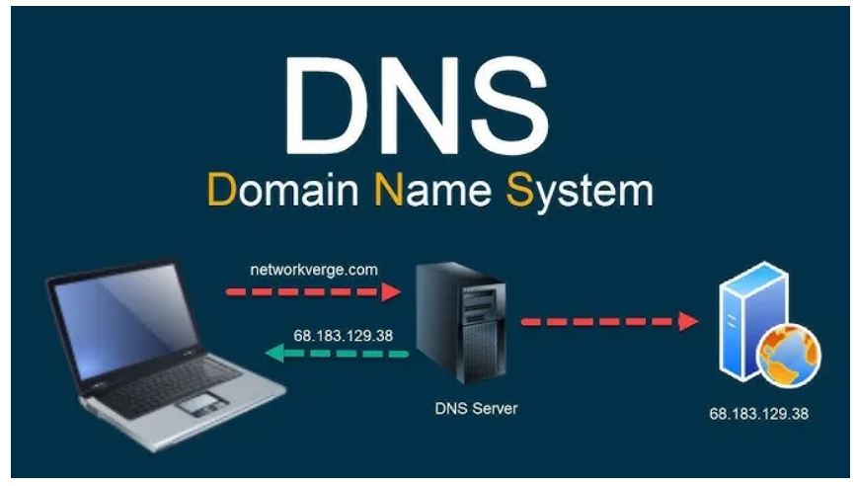
Network Information/ Settings needed for connectivity
DNS Server
A server that translates domain names into IP addresses,
User-Friendly Access – Humans remember names easier than numeric IP addresses.
1. You type networkverge.com in the browser.
2. Your computer sends a DNS query to the configured DNS server (via the default gateway).
3. The DNS server resolves the domain name to an IP address and sends it back to the client. (If DNS server doesn’t know → asks a Root DNS server (the “Internet’s phonebook”) via a public DNS server such as google DNS server.
4. Your computer sends an HTTPS request to that IP address through the default gateway.
5. The server responds and the webpage loads.

Slide 20
Network Information/ Settings needed for connectivity
IP Address Assigment Methods:
Dynamic IP address Assignment
Automatically assigns IP Address settings to devices on a network.
Uses Dynamic Host Configuration Protocol (DHCP) server, which dynamically allocates IP addresses from a predefined pool e.g for 200 devices assign Ips from this pool: 192.168.80.1 – 192.168.80.200
Commonly used in large networks to simplify IP address management – more efficient.
IP address assigned dynamically is only temporarily assigned to a device for the defined lease period.
The IP address goes back in the pool after lease period expires. The device is assigned a new IP next time it connects to the network.

Slide 21
Network Information/ Settings needed for connectivity
IP Address Assigment Methods
2. Static IP address assignment
Manually assigning IP address settings to devices.
The IP address remains fixed until changed.
Assigned to devices that requires a fixed address, e.g. server/printer.
Also used in networks with fewer devices.
Not efficient for larger networks (time consuming, risk of IP conflicts)

Slide 22
Network Architecture
Network architecture defines There are two common network architectuhow network devices are connected and communicating over the network.
res:
Client-Server Architecture
Peer to Peer Architecture

Slide 23
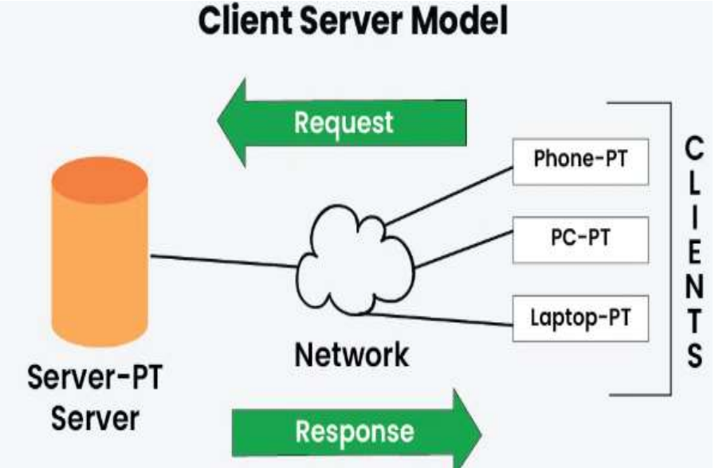
Client-Server Architectures
In a client-server architecture, network resources and services are distributed between clients (end-user devices) and servers (centralized resources).
Clients make requests, and servers fulfil those requests.
An architecture where end-user devices (clients) request services or resources from a server.
E.g.: Web browsers (clients) accessing a website hosted on a web server.
server:
Always wait for request from hosts
Serves the clients’ request
Centrally manages resources & processes data
permanent IP address
Clients:
Communicate with the server
Request for resources from the server
May have dynamic IP addresses

Slide 24
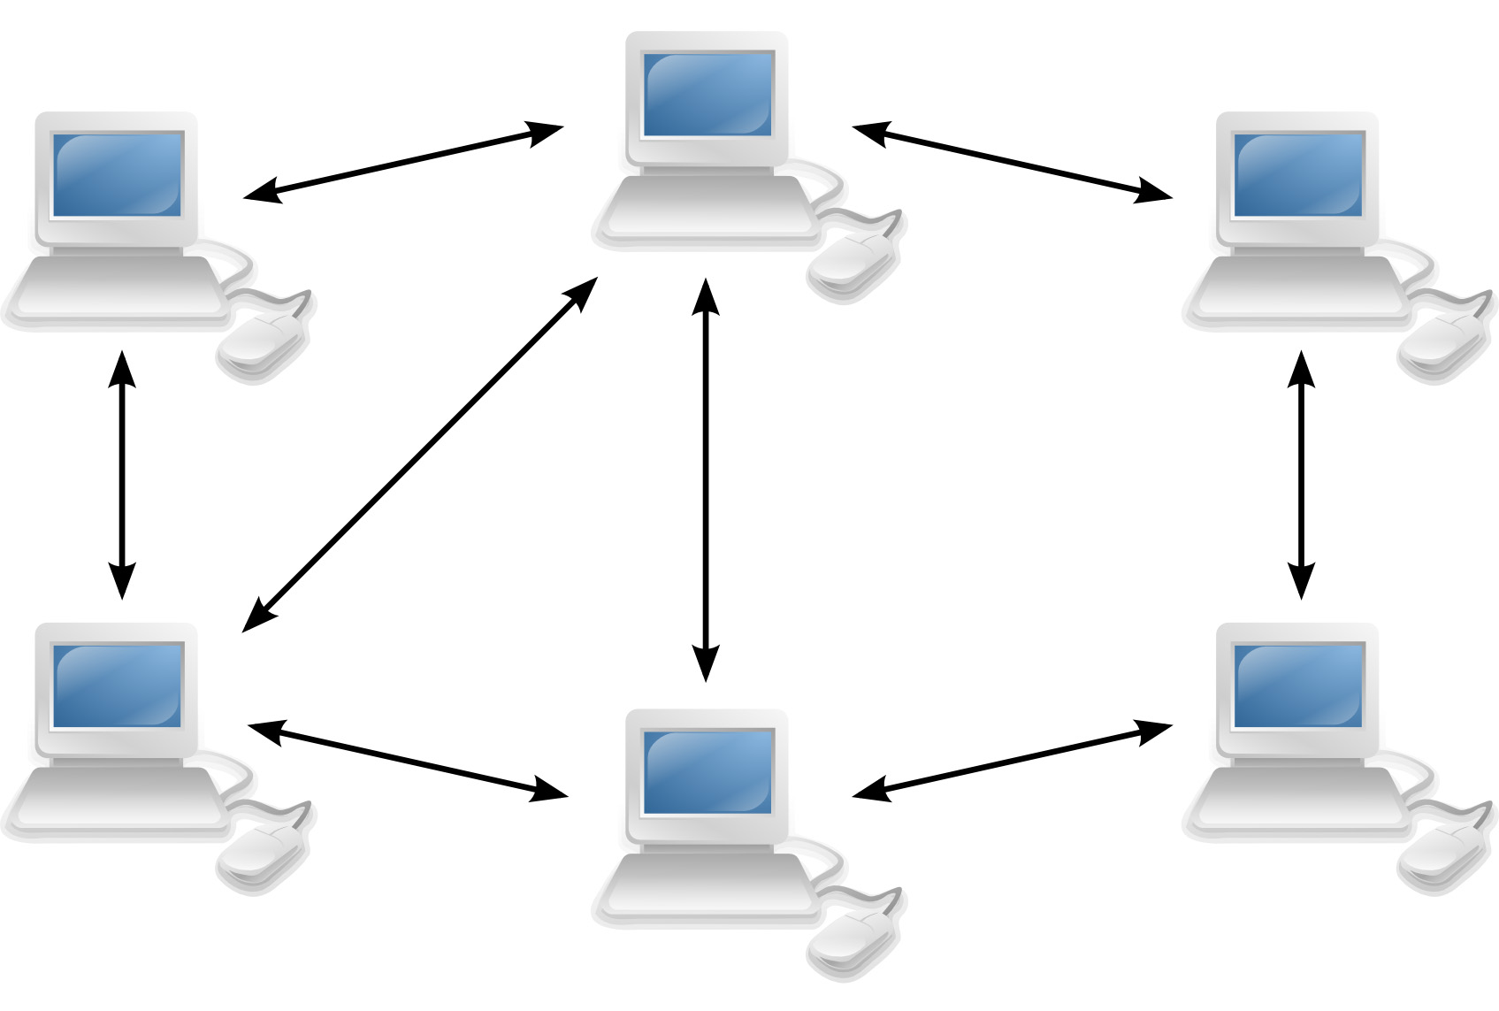
Peer to Peer Architecture
In a peer-to-peer architecture, all devices (peers) have equal status as client and server. Each device can share resources directly with others.
Decentralized structure with no dedicated servers.
Each device has its resources, and communication is directly between peers.
peers request service from other peers, provide service in return to other peers
Common in small networks, file sharing and collaborative applications.

Slide 25
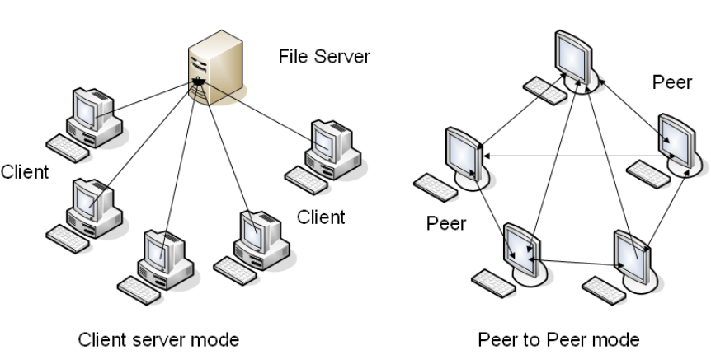
Network Architecture
Client-Server vs Peer to Peer

Slide 26
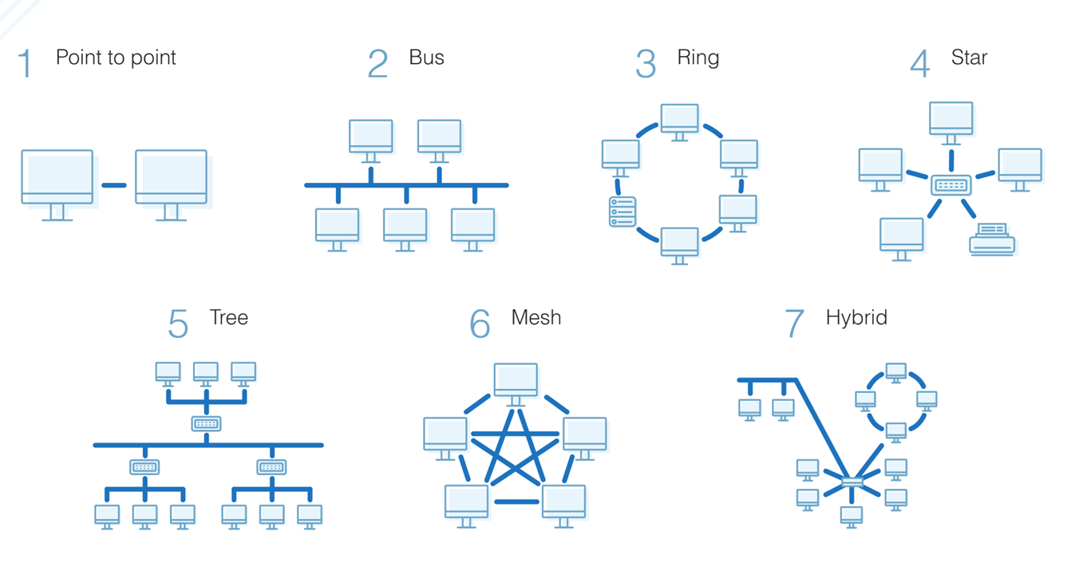
Types of Network Topology
Topology refers to the physical layout of different components on the network (links, nodes).
The various topologies offer varying levels of performance, scalability, and fault tolerance.
There are various topology categories, some common types of network topologies:

Slide 27
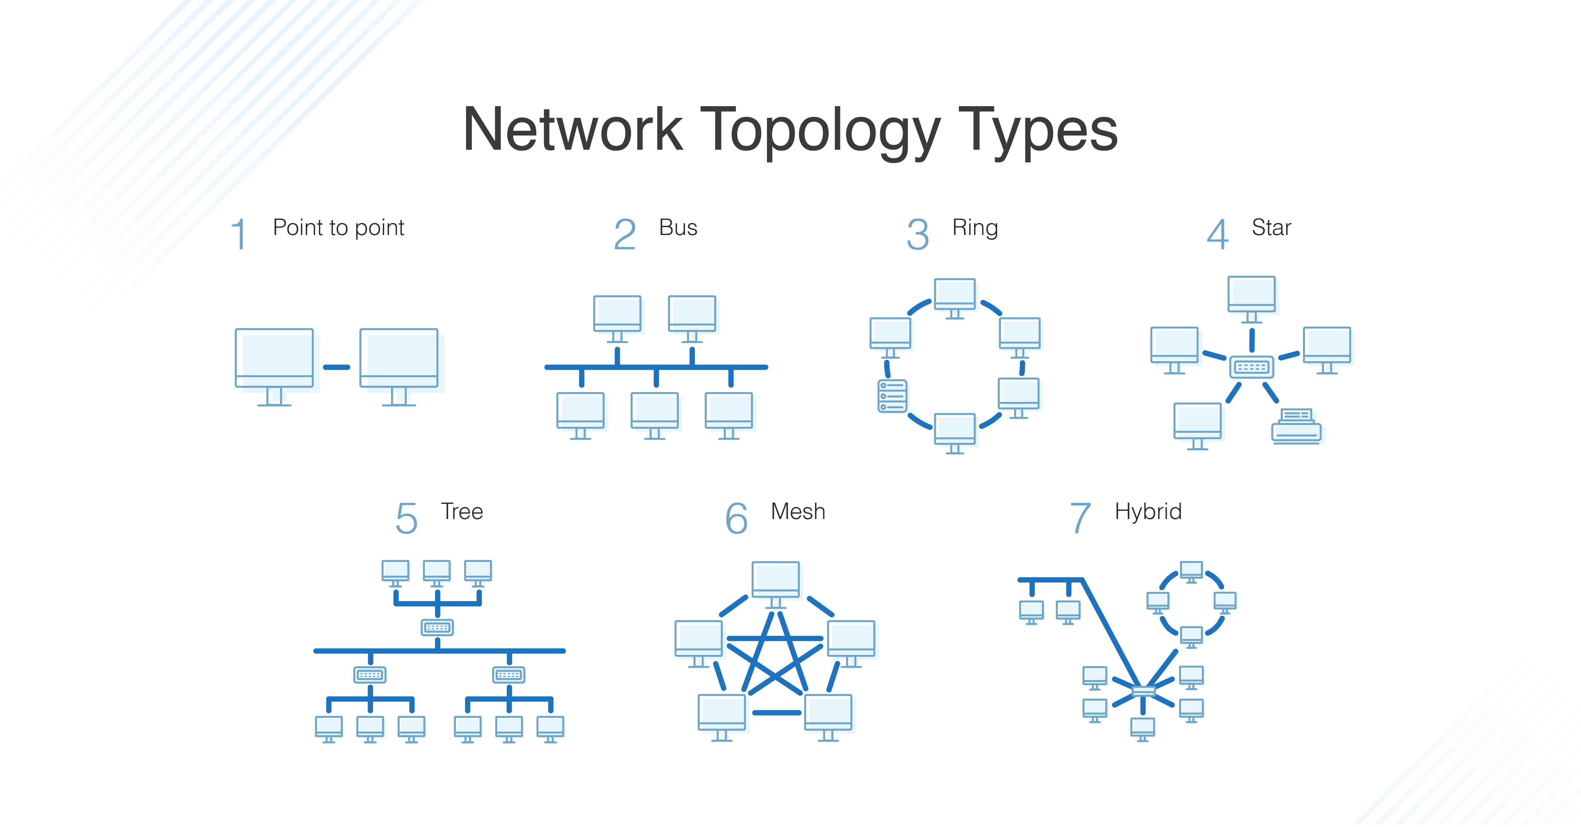
Types of Network Topology
1. Point-to-Point Topology
Two devices that are directly connected, also known as a "dedicated link“.
Advantages of Point-to-Point Topology:
Simple network architecture making it easy to set up and configure.
High performance and low latency (link is dedicated for 2 devices only)
More secure
Disadvantages of Point-to-Point Topology:
Limited Scalability – only connects two devices
High cost – every new connection requires dedicated link
Lack of redundancy – single point of failure

Slide 28
Types of Network Topology
2. Ring Topology
Each device is connected to the two devices on either side forming a ring.
Advantages of Ring Topology
Easy to install.
Managing is more straightforward as to add or remove a device from the topology; only two links are required to be changed.
Disadvantages of Ring Topology
A link or node failure can fail the entire network as the signal will not travel forward due to failure.
Adding or removing devices disrupts the network – the ring must usually be broken to make changes

Slide 29
Types of Network Topology
3. Star Topology
All devices are connected to a central hub or switch.
Advantages of star topology
Centralized network management using the central device, hub or switch.
Easy to add another computer to the network.
If one end device fails, the rest of the network usually functions. No single point of failure (node failure)
Disadvantages of star topology
May have a higher cost to implement, especially when using a switch or router as the central network device.
If the central device fails, the entire network goes down and all devices are disconnected. - single point of failure

Slide 30
Types of Network Topology
5. Mesh Topology
Every device is connected to every other device in the network.
Advantages of star topology
High fault tolerance; multiple paths available for data transmission.
Scalable and can handle many nodes.
Disadvantages of star topology
Complex network infrastructure,
Expensive to implement,
Troubleshooting complexity

Slide 31
Types of Network Topology
6. Hybrid Topology
Network structure that combines two or more different network topologies (e.g., star, bus, ring) into one network.
Simple topologies form one complex network.
Advantages of Hybrid Topology
Highly Flexible – Can be designed according to organizational needs.
Scalable – Easy to add new devices or segments.
Reliable – Failure in one segment does not affect the entire network.
Better Performance – Can combine strengths of different topologies.
Disadvantages of Hybrid Topology
Expensive – Requires more cabling and networking devices
Complex Design – Difficult to design and manage.
Hardware Intensive – Needs hubs, switches, routers, etc.

Slide 32
---END---

